Slide 1



Publix Brand
Corn Meal & Flour
Review
May 6, 2013

Slide 2
Midstate Mills, Renwood Mills
Company History
In 1935, G.D. Drum put his life savings on the line in exchange for the Maiden Flour Mill .
Working side by side with two employees, Mr. Drum had by 1937, increased daily production
from 2,500 to 17,500 pounds. More importantly, his reputation for honest dealing, sound financial
policies, and for providing good products at competitive prices had allowed him to gain a secure foot
hold in the marketplace for Midstate Mills
Over the ensuing 75 years, Midstate Mills has expanded its product line of flour, corn meal, and
convenience baking mixes.. The Company serves over 3,000 retail grocery
stores in six states including North Carolina, South Carolina, Georgia, Virginia, Tennessee, and
Kentucky. In addition, Midstate Mills sells its products to some of the largest restaurant chains and
foodservice distributors in the country. Through all of this growth, Midstate Mills is committed to providing the finest southern baking products that are healthier and more convenient for today’s time pressed consumer.
February 2013 Renovo Capital and Rosewood Partners acquired Midstate Mills and became Renwood Mills accelerating growth and innovation to perpetuate and expand the successful business l nurtured by the Drum and Arndt Families throughout the Southeast United States.

Slide 3
Renwood Mills
Company Structure
Renwood Mills is a privately held and operated milling company based in Newton, North Carolina
Founded in 1935, We are the oldest, continuously operating flour and corn meal operation in the Southeast U.S.
Renwood Mills competes in four distribution channels:
  Retail Consumer Products (Flour, Corn Meal, Baking Mixes)
  Foodservice Distributor
  Foodservice National Accounts
  Commercial
Midstate Mills had sales in excess of $40 million in FY2012 after divesting the Feed and some Bulk Ingredient business.
Renwood Mills currently employs just under 100 people.

Slide 4
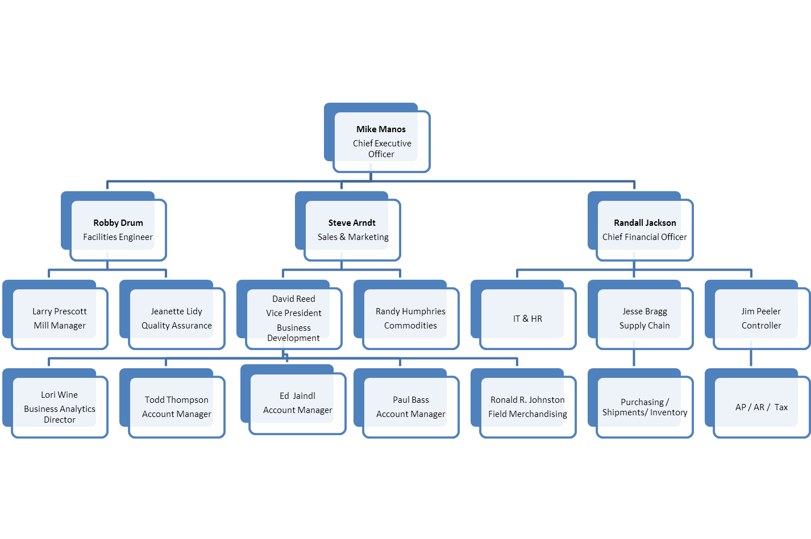
Renwood Mills
Organizational Chart

Slide 5
Renwood Mills
Company Philosophy & Ethics
Recognizing our responsibilities in the furtherance of
public welfare and of rightful relations among men,
we pledge ourselves –
To - Use high grade materials and to seek by every means to enhance the purity and wholesomeness of our products.
To - Employ at an adequate wage, workers of character and dependability and to provide conditions favorable to their welfare, encouragement and development.
To - Maintain a high standard of cleanliness and sanitation in connection with all operations and in all buildings where food products are manufactured or stored.
To - Comply with the food laws, both state and federal, and to cooperate fully with officials charged with their enforcement.
To - Represent our products truthfully at all times in our advertising, no less than in our labeling.
To - Know accurately our cost of management, productions and distribution, in order that a fair price, a fair wage and a fair profit may be assured.
To - Compete always with fairness, securing patronage on merit and without derogatory reference to a competitor or his goods.
To- Be guided by a sprit of fair dealings in our relations with our employees, our customer’,s, our suppliers and all others with whom we do business.

Slide 6
Renwood Mills
Strengths & Capabilities
Strengths
Private Ownership allows company to be very nimble and responsive
Sources bulk of grains from local farmers which ensures freshness and low cost
Expertise in soft wheat milling
Focus on new to the world baking products & packaging
Capabilities
Leader in Soft Wheat Flour Milling
Corn Milling can handle both white & yellow corn
Premium Baking Mixes
Innovator in eco-friendly, re-sealable pouch packaging
Grass Roots Marketing
Alliance with major universities in product and consumer research

Slide 7
Renwood Mills Advantages
Strengths & Capabilities
Renwood Mills is a $40 MM company with a $500MM capacity
We supply most Southeast USA’s private label and ALL of the successful private label programs in Southeast USA.
IRI data consistently reveals how our preferred blend of wheat flour yields over two times stronger category growth and private label growth than other suppliers.
Production responses are heroic in short timing, rallied responses . Fill rates 99.7% consistently
QA process and testing is among best in the industry
Full BRB and Global Food Safety Initiatives A scores since inception
Innovation leaders- most new items and new packaging features IN LAST 5 YEARS and capable of more

Slide 8
Renwood Mills Advantages
  Family Values. Privately owned.
  Innovation Leaders
  New growth dollars invested
  Strong Regional Brands
  Strong Regional Brand Heritage
  Grass Roots Marketing Events
  Business Analytics Brilliance & Credibility
  Established Expert Direct Representation
  Category Focus
  Mill / Plant Elasticity
  Marketing Leadership
  Unique Soft Red Winter Wheat Experts
  Bolder Corn Meals
  Distinctive Milling – We go above and beyond the normal processing

Slide 9
Renwood Mills
Manufacturing & Distribution
Manufacturing
In a single hour, our plant mills and blends enough flour and corn meal to make:
  790,000 biscuits
  Over 35,000 cornbread muffins or 72,000 individual servings of grits
Experts in soft red winter wheat milling / Nine Break levels
--- PREFERRED SOUTHERN PROFILE
Focus on new to the world baking
products & packaging
Demand vs. Milling scheduling
Distribution
Single Distribution center in Newton, NC 50,000 square feet.
Additional DC space leased in Atlanta
Products distributed from the Mississippi River to Atlantic Ocean, and Interstate 70 to Gulf of Mexico

Slide 10
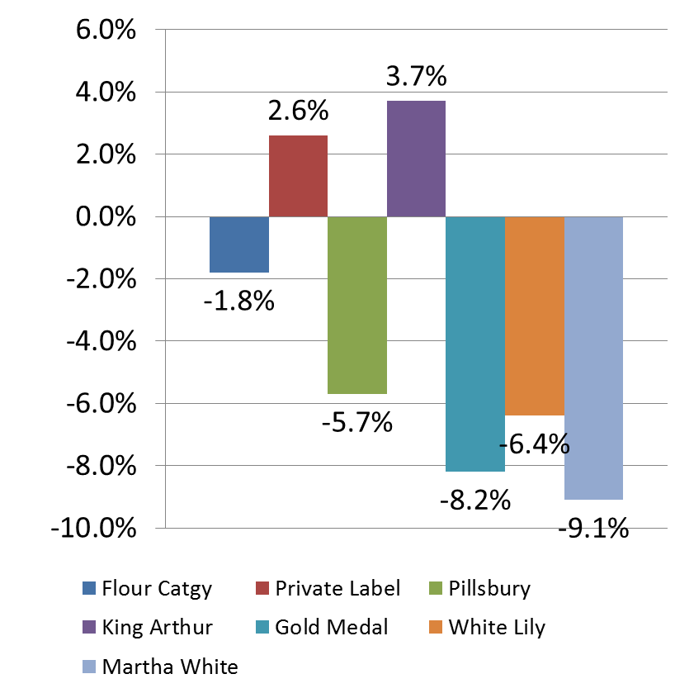
Renwood Mills
Publix Flour Category Overview
Flour Brand % Unit Growth
At Publix, Flour is a $17.7 million category totaling 7.2 million units
Over the most recent 52 weeks, unit sales were -1.8%, while Publix Brand was up 2.6%
National brands are pulling overall category down in volume with Martha White & Gold Medal leading the decline – caused by lower grade and hard wheat
The average category price is $2.47 with Private Label 33% lower at $1.85
Source: Publix Corp. 52 week IRI p.e. 12/31/2012
Notes:
Note: 2.6% - P/L $52,626, units 56,661……3.7% is King Arthur, $110,271, units 35,412

Slide 11
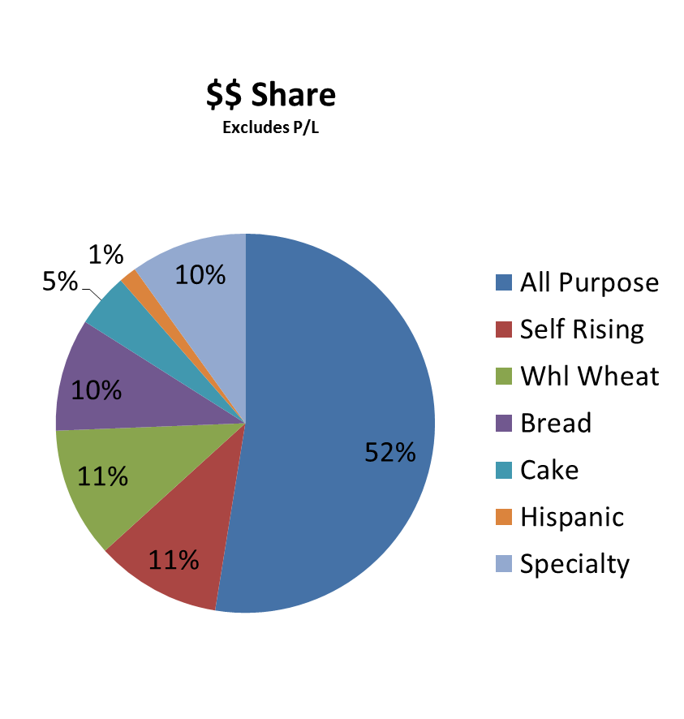
Publix
Flour Variety
According to IRI, Publix has 88 (up from 78, three years ago) active flour SKU’s
52% of the category volume is All-Purpose
Self-Rising is 1/3 less than other southern retailers
Specialty high margin items are 1/3 higher at Publix than other southern retailers, and represents 11%
  Two trial and promotion opportunities for Publix brand are Self –Rising and Specialty items
Source: Publix Corp. 52 week IRI p.e. 12/31/2012

Slide 12
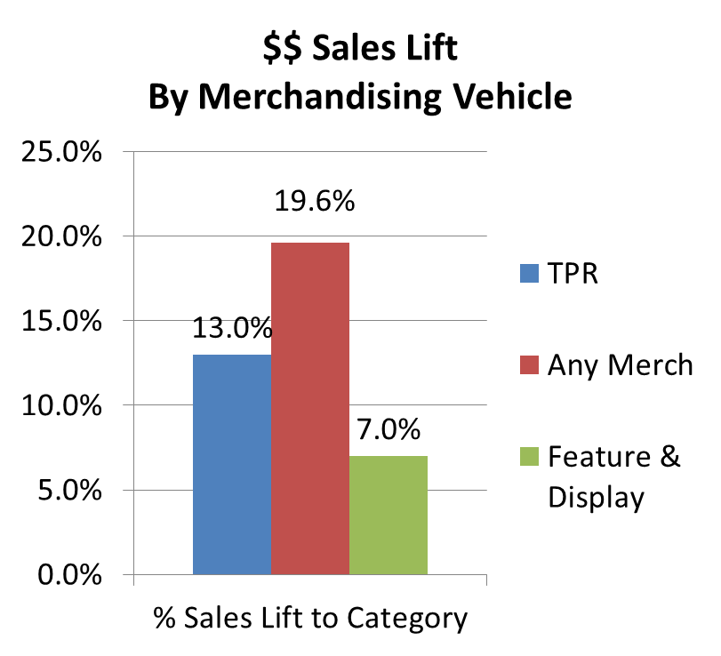
Renwood Mills
Publix Flour Category - Sales Lifts
Lack of merchandising has stalled the category with a
-42.3% in $$ for merchandising of features/displays
Only 7% of total $$ were Features/Displays
In 2009 - Feature and Display
programs drove almost
18 times more sales lift
than a TPR alone
Flour features during key
seasonal periods will drive
incremental growth
  Display/feature & trade $$ and primary destination
  Loyalty opportunities
Source: Publix Corp. 52 week IRI p.e. 12/31/2012

Slide 13
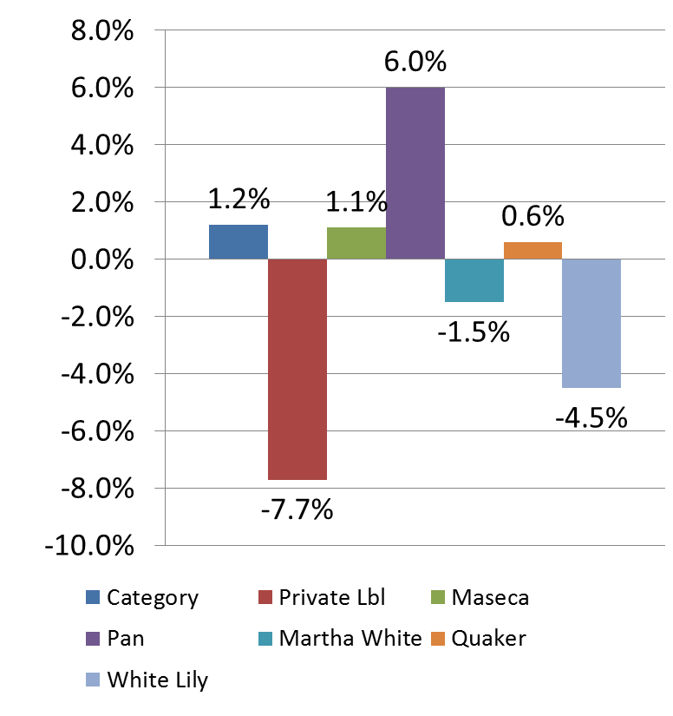
Renwood Mills
Publix Corn Meal Overview
At Publix, Corn Meal is a $5.4 million dollar category annually
Unit volume is 2.4 million annually
Hispanic products are growing the category – Publix brand opportunity!!
Lack of merchandising for Publix brands and lack of trade $$ from National brands have decreased category attention
The average category price is $2.22, with Private Label 43% lower at $1.55
Corn Meal Unit % Growth
Source: Publix Corp. 52 week IRI p.e. 12/31/2012

Slide 14
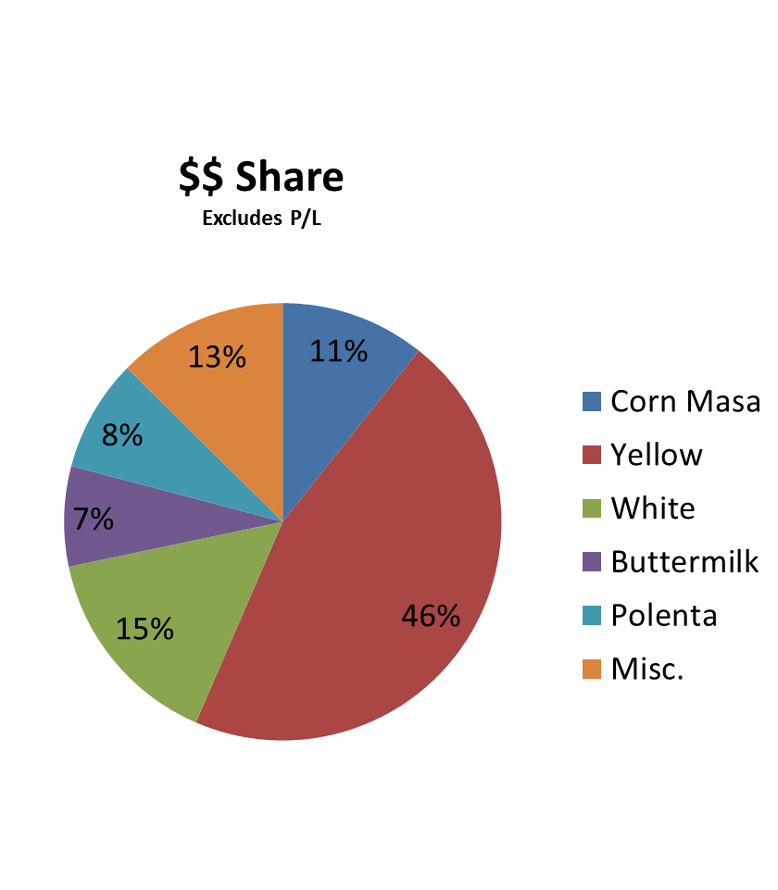
Publix
Corn Meal Variety
According to IRI, Publix has 78, (increase from 47, three years ago) active Corn Meal SKU’s
46% of the category volume is yellow
Publix should consider adding a store brand polenta or corn masa varieties – spec P.A.N. import from South America
Source: Publix Corp. 52 week IRI p.e. 12/31/2012

Slide 15
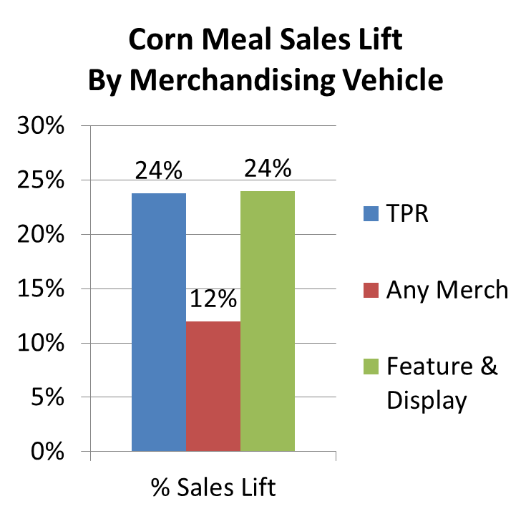
Renwood Mills
Publix Corn Meal Category - Sales Lifts
Corn Meal merchandising has increased 23.4% for the category
Private Label is -75% in merchandising. Sales are flat
12% of category total $$ is promotional, Publix brand less than 1%
National Brands are not spending Publix’s fair share of trade dollars - Use Publix brand to capture that money!
+ Display Publix Brand.
Source: Publix Corp. 52 week IRI p.e. 12/31/2012

Slide 16
Renwood Mills
Publix continues to benefit from Renwood’s Proficient Provision
Of Preferred SOUTHERN PROFILES
What
Higher Yields
Whiter, less ash, less protein
Fluffier Biscuits and cakes, Flakier Pie Crusts and Pastries
Melting Mouth-feel texture
Higher moisture absorbion from environment
How
Incremental Cleaning steps
Added “Breaks” in Milling Process
Higher levels of Carolina grown soft red winter wheat
Expertise in soft wheat milling
Reflects Mill personality from evolution in equipment and Mill
Less De-Germing, more Flavor

Slide 17

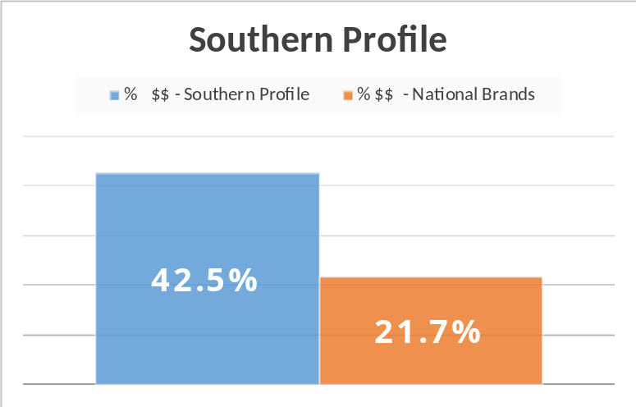

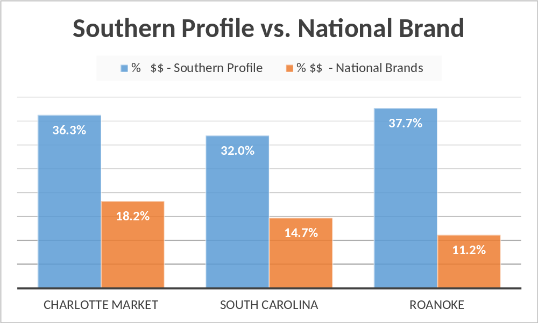

Renwood Mills
Renwood Supplies Preferred Southern Profiles
that prove over multiple years and multiple markets to Consistently outperform Hard Wheat blends and fewer processing steps
Overall the Southern Profile is preferred 2x more than hard Wheat in Branded and Private in Southeast U.S.
Throughout the Southeast, Soft red winter wheat is the preferred flour in each Southern Market over hard wheats
Source: Publix Corp. 52 week IRI p.e. 12/31/2012

Slide 18

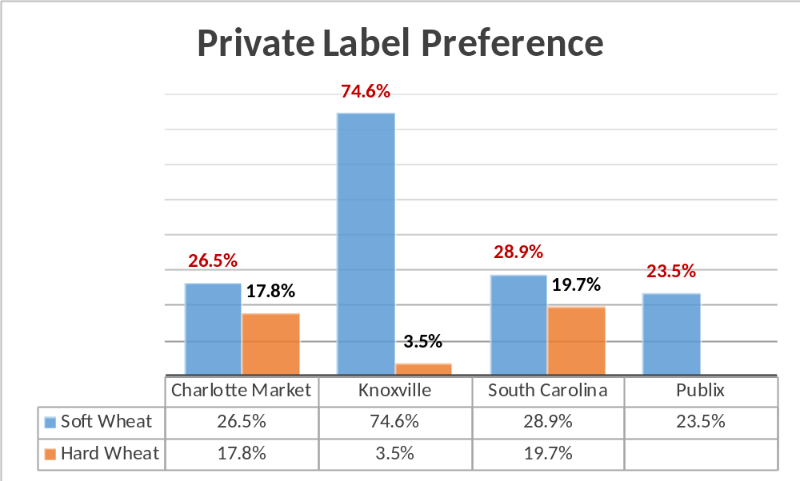
Renwood Mills
Private Label $$ Sales
Renwood Supplied Private Labels deliver Higher Category
Size and Growth vs. All Other Suppliers in Southeast
Source: Publix Corp. 52 week IRI p.e. 12/31/2012

Slide 19
Renwood Mills
Publix benefits from Renwood Supplied Private Labels delivering Higher category Size, Sales / Loyalty vs. All Other Suppliers in Southeast
Metric | SE US Mkt-KR | Publix | Retailer 1 | Retailer 2 | Retailer 3 | Retailer 4
CTGRY size $$’s | 255 MM | 17.7MM | 15MM | 9.3MM | 3MM | 1MM
PL Share | 19 | 23.5 | 26.5 | 9.0 | 19.6 | 20.4
Avg CTGRY price | 2.45 | 2.47 | 2.26 | 2.94 | 2.46 | 2.42
Avg PL Price | 1.80 | 1.85 | 1.57 | 2.28 | 1.84 | 1.92
PL $$’s sold per point Dstrbn | 12,753 | 41,605 | 3,787 | 853 | 3,887 | 1,283
Indicators of slowed category growth from
less Trade spend from national Brands at Publix
Source: IRI 52 weeks 2012

Slide 20
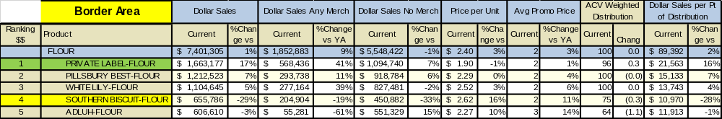
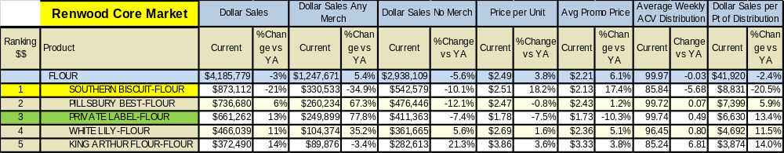
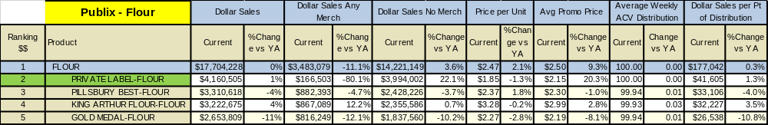
Our preferred Southern Profile Drives Destination Loyalty
Top 5 – Brand - Flour
P/L continues to lead SC Market, with Southern Biscuit holding overall 4th, with highest retail price increase and decline in promotional activity.
Southern Biscuit remains #1 with highest retail price increase, while P/L has seen a 13.1% $$ increase, which is leading the category.
P/L continues to lead Publix market and outpacing category, while National Brands pull overall category down!
Source: IRI 52 weeks 2012

Slide 21
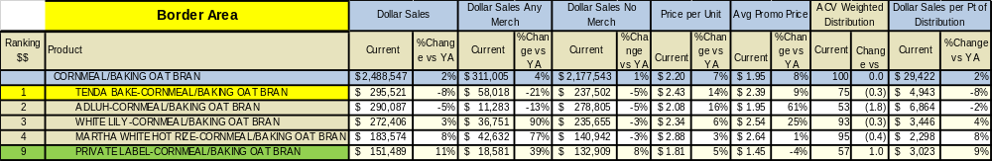
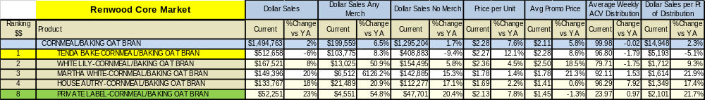
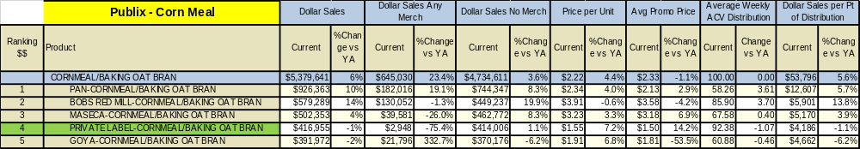
Top 5 – Brand – Corn Meal
Unique Milling drives product loyalty
Tenda Bake continues to lead the SC market, while P/L has the strongest increase in $$ at 11%.
Tenda Bake remains #1 in the Charlotte market and performs over 3X than the next brand on Points of Distribution. P/L is #8 with a 22% $$ increase.
P/L had the least amount of promotions while Goya increased all their promotional activity to compete directly with P/L on price
Source: IRI 52 weeks 2012

Slide 22
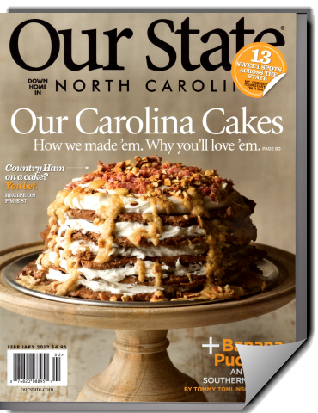

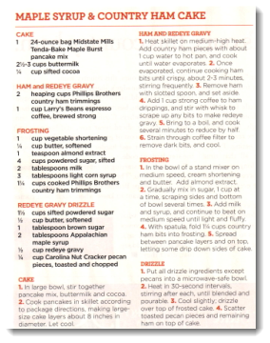
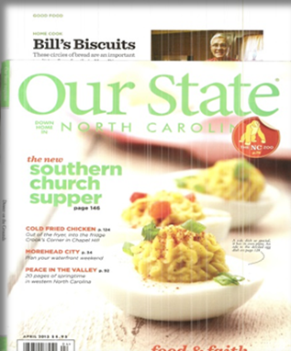

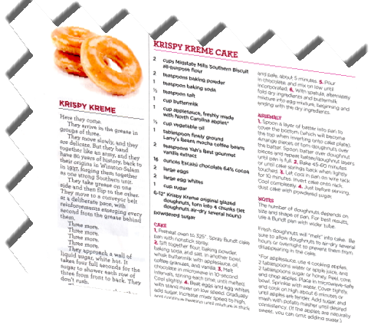
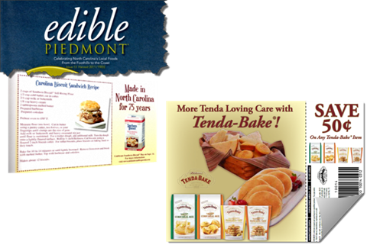
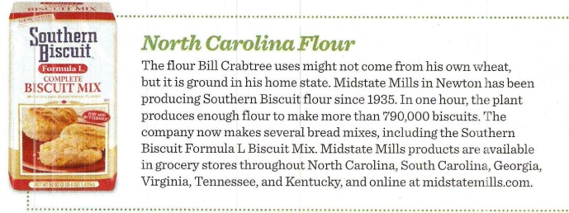


Renwood Mills
Southeast Presence, Proliferating Preferred Southern Profile
Our Pancakes are featured on the cover of the February 2012 issue April 2013 as best Biscuit Flour
Over 5 Million Viewers
Regional FSI’s

Slide 23
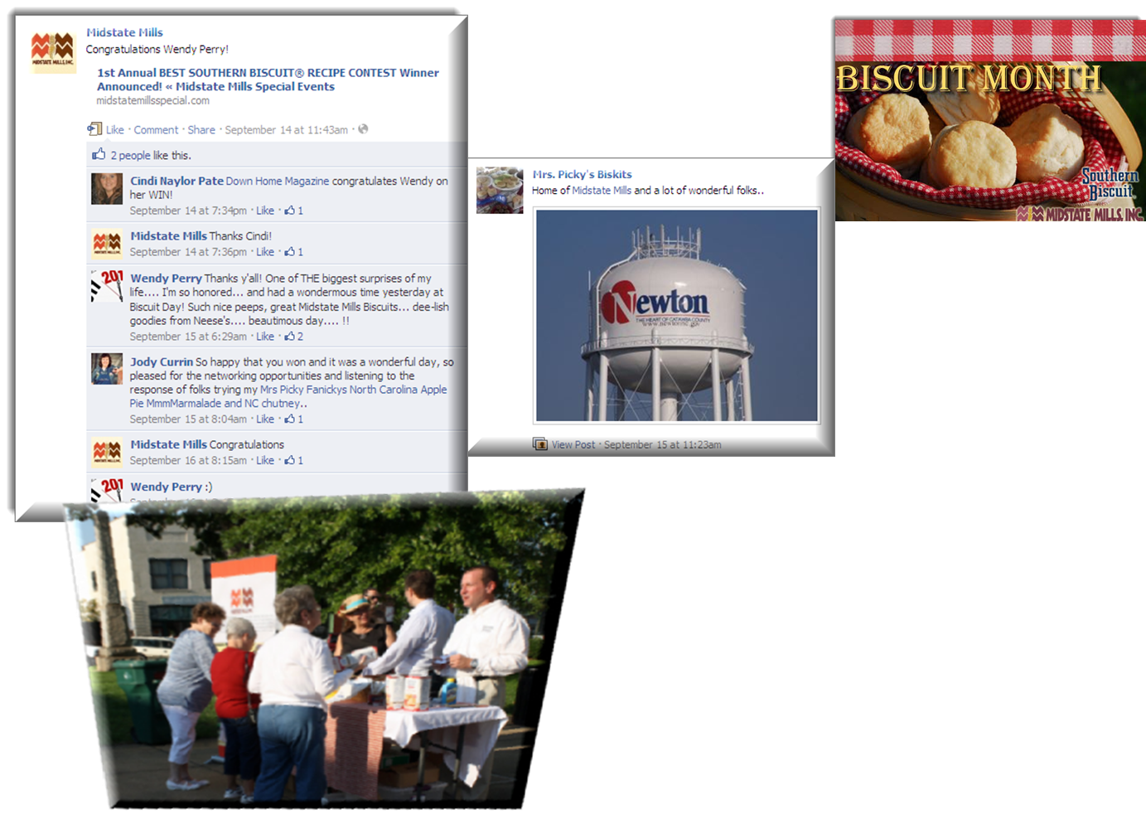

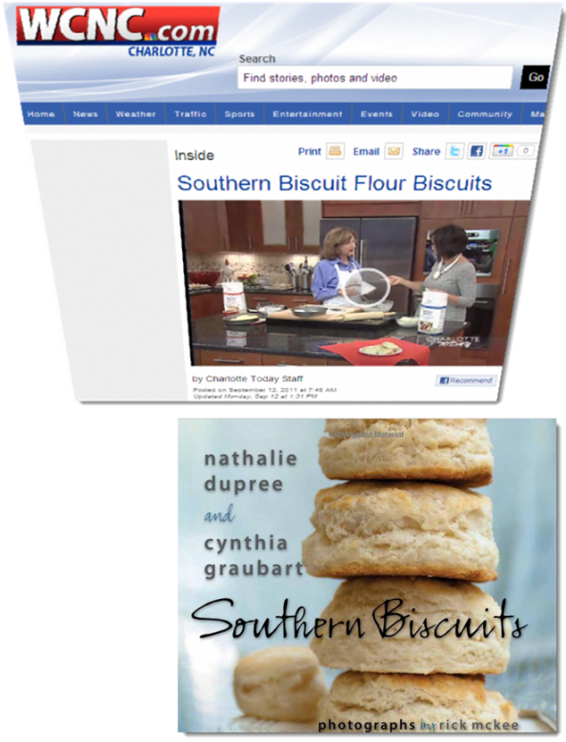

Renwood Mills
Southeast Presence, Proliferating Preferred Southern Profile
Author and food expert Nathalie Dupree has also mentioned us in her book – and uses our flour

Slide 24

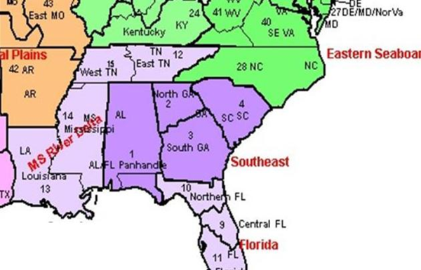

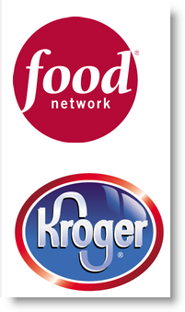


Renwood Mills
Southeast Presence, Proliferating Preferred Southern Profile
Major sponsor of the International Biscuit Festival held during May in Knoxville – over 20,000 people attended 2011 and 25,000 in 2012!!
#1 Food Festival in the Nation
2012 Additional Sponsors – Alton Brown touted Southern Biscuit as the best during his show

Slide 25
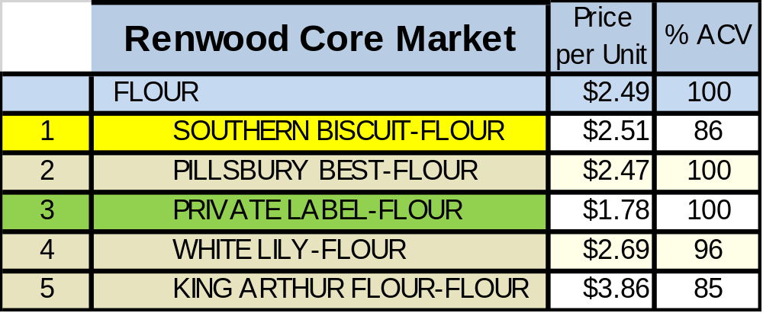
Renwood Mills
Flour Pricing & ACV
Southern Biscuit flour is #1 in core market while P/L comes in at #3, with a higher average retail than in the Publix market
Flour pricing in the Publix region is overall lower than in the Renwood Core market, except for P/L
 | Publix | Price per Unit | % ACV
 | FLOUR | $2.47 | 100
N/A | SOUTHERN BISCUIT-FLOUR | N/A | N/A
3 | PILLSBURY BEST-FLOUR | $2.37 | 99.72
1 | PRIVATE LABEL-FLOUR | $1.85 | 100
7 | WHITE LILY-FLOUR | $2.51 | 60
4 | KING ARTHUR FLOUR-FLOUR | $3.28 | 99
Source: 52 week IRI p.e. 12/31/2012

Slide 26
Renwood Mills
Retail Flour Pricing
Item | Publix | Wal*Mart | Sweet Bay
5# Priv. Lbl | 2.29 | 1.78/ 2.38 Lite | 2.49
5# Gld Med | 2.39 | 2.14 | 3.19
5# Pills | 2.99 | 2.12 | 3.24
5# King Art | 4.19 | 3.69 | 4.99/4.59SR
5# Wht Lily | 3.19 | 2.78 | 3.39
2# Priv Lbl | 1.49 | 1.38 | 1.59
2# Pills | 1.79 | 1.68 | 1.89
10# GM | N/A | N/A | N/A
10# Pills | N/A | 3.98 | N/A

Slide 27
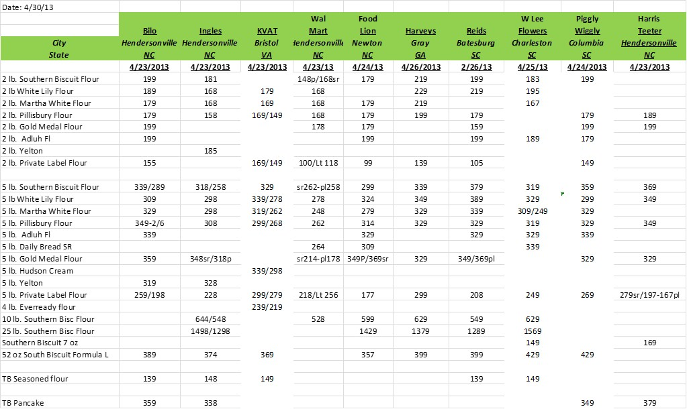
Renwood Mills
Retail Flour Pricing

Slide 28
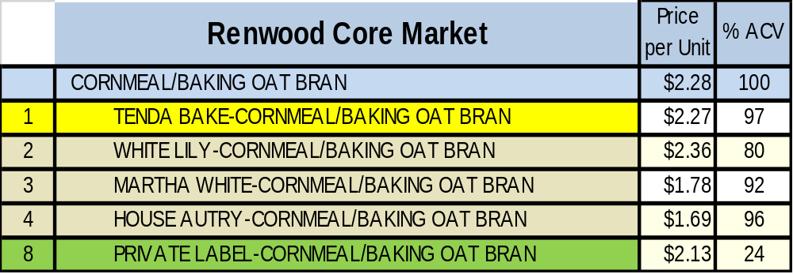
Renwood Mills
Corn Meal Pricing & ACV
Tenda Bake Corn Meal #1 in core market while P/L comes in at #8, with a higher average retail than in the Publix market
Corn Meal pricing in the Publix region are overall lower than in the Renwood Core market, except for White Lily
 | Publix | Price per Unit | % ACV
 | CORNMEAL/BAKING OAT BRAN | $2.22 | 100
N/A | TENDA BAKE-CORNMEAL/BAKING OAT BRAN | N/A | N/A
8 | WHITE LILY-CORNMEAL/BAKING OAT BRAN | $2.42 | 30
6 | MARTHA WHITE-CORNMEAL/BAKING OAT BRAN | $1.69 | 97
12 | HOUSE AUTRY-CORNMEAL/BAKING OAT BRAN | $1.48 | 97
4 | PRIVATE LABEL-CORNMEAL/BAKING OAT BRAN | $1.55 | 99
Source: 52 week IRI p.e. 12/31/2012

Slide 29
Renwood Mills
Retail Corn Meal Pricing
Item | Publix | Wal*Mart | Sweet Bay
2# Priv Lbl | 1.49 | N/A | 1.37
2# AJ | 1.29 | DISC | N/A
2# Mar Wht | 1.95 | 1.64 | 1.78
4.4# Maseca | 2.75 | N/A | N/A
5# White Lily | 2.99 | 2.62 | 3.85
5# Priv Lbl | 2.59 | 2.99 | N/A
5# Mar Wht | 3.59 | 2.04 | 2.79
2# Hse Atry | 1.69 | N/A | N/A
2# White Lily | 2.15 | 1.68 | 2.49

Slide 30
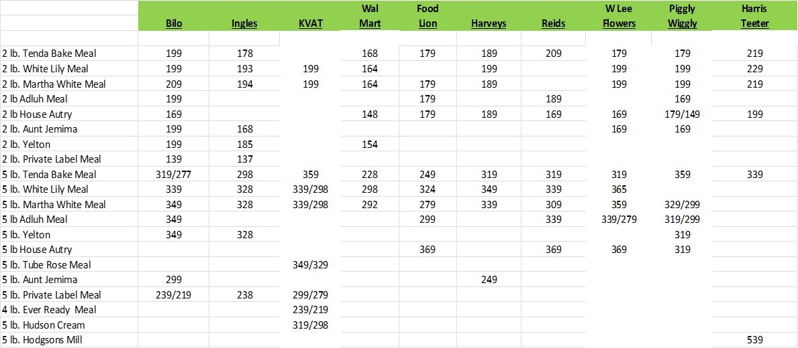
Renwood Mills
Retail Corn Meal Pricing

Slide 31
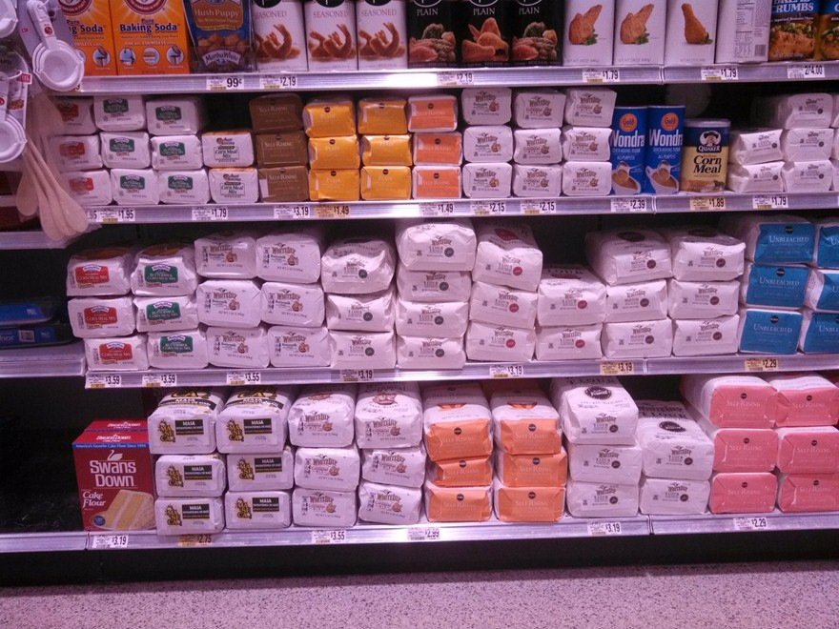
Renwood Mills
Publix Corn Meal Set

Slide 32
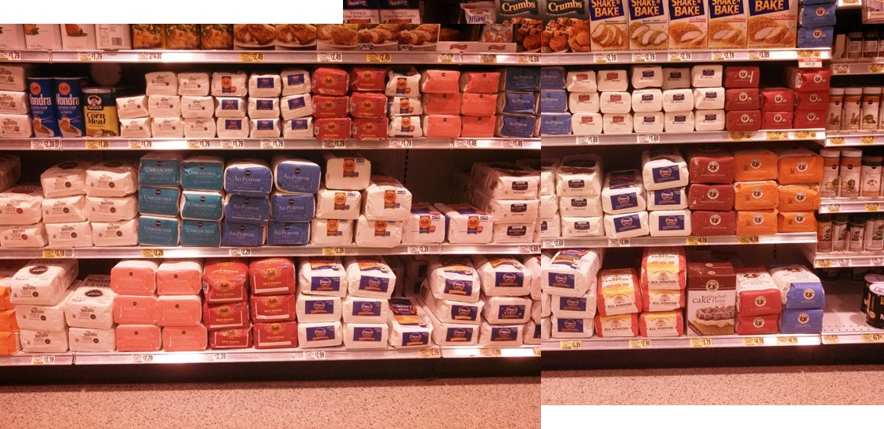
Renwood Mills
Publix Flour Set

Slide 33




















Renwood Mills
Customer Base
Renwood Mills has a very broad and blue chip customer base including the following:

Slide 34
Renwood Mills
Competition
In retail grocery, Renwood Mills competes with the following:
Flour Corn Meal Private Label
Gold Medal Aunt Jemima Southeastern Mills
Pillsbury Maseca ConAgra
King Arthur Martha White ADM
White Lily White Lily
Bob’s Red Mill Albers Martha White Sunflour

Slide 35
Renwood Mills
Future Growth Plans
Renwood Mills is currently investing heavily in consumer & product research, packaging, and new product R&D to develop fresh, innovative products along three platforms:
  Convenience
  Indulgence
  Health & Wellness
Expansion will come from new retail grocery product lines as well as geographic expansion to additional markets in the Southeast
Renwood Mills will leverage their single minded focus on dry baking products to provide consumers with meaningful differentiation in product, packaging, and sustainability.

Slide 36
Renwood Mills
Product Line Innovations
24 – 28 oz. Line of Tenda-Bake Pancake Mixes in stand-up, re-sealable pouches (Q3, 2009)
  Buttermilk 28 oz
  Maple Burst
  Seven Grain
  No Sugar Added Pancake Mix
5 Lb. Buttermilk Corn Meal Mix (Q4, 2009)
10 oz. Seasoned Flour (Q1, 2010)
4 Lb. Line of Culinary Grade Flours (Q2, 2010) endorsed by Shirley O. Corriher, author of Bakewise
(Q1, 2010)
7oz pouch Formula L Biscuit Mix Q1 2012

Slide 37
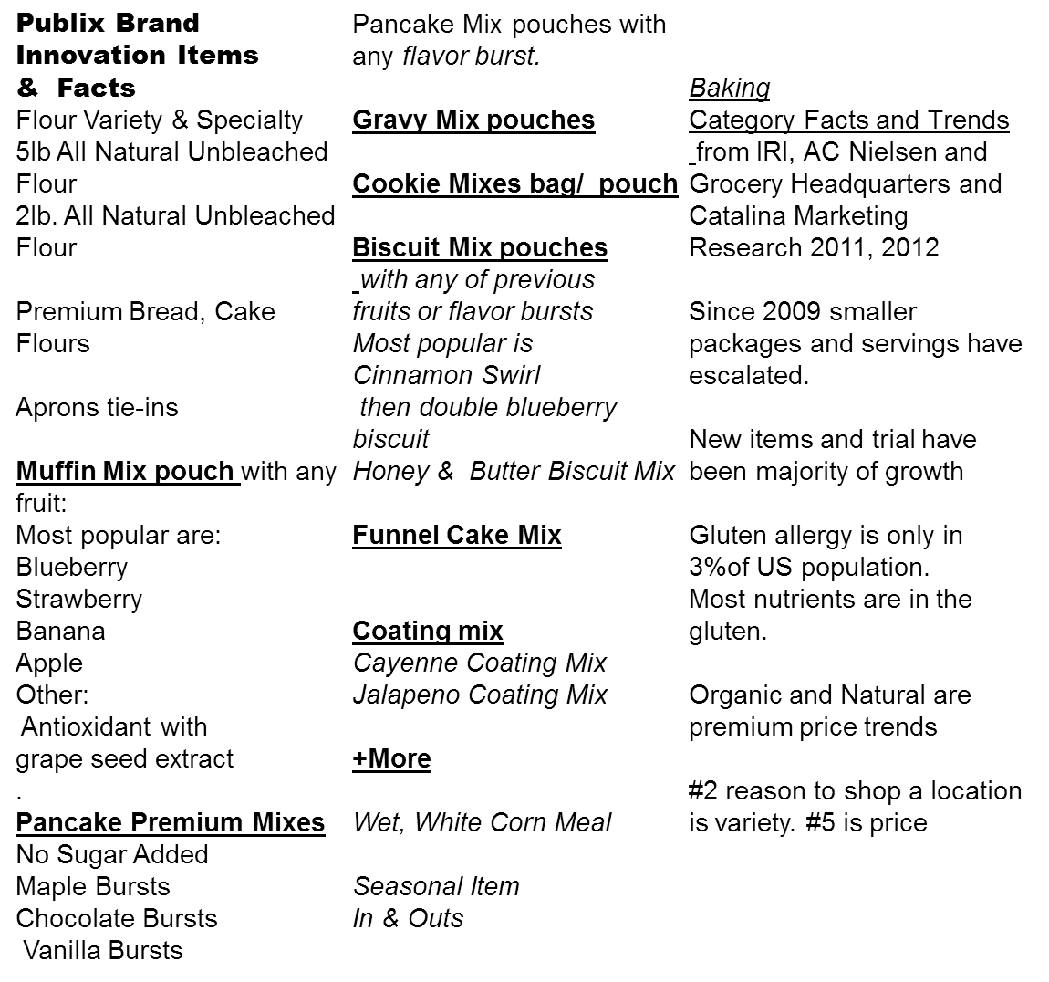

Slide 38
Renwood Mills
Improvement Recommendations
Feature and Display Publix Brand Flour and Corn Meal more aggressively during peak seasonal periods= Sales and CPG $$’s
Add Buttermilk Corn Meal Mix to the Publix Brand line
Dual Language Labeling
Add more flavor variety to all your baking mix categories, potential for Publix Brand line of specialty flours= Attention/ Excitement
Monitor price points to not exceed 20% premium vs. Supercenter formats on like items
Support culinary flour introduction in Q2, 2013. Potential exclusive for early distribution.

Slide 39
Renwood Mills
Key Partnership Benefits
Privately Owned Renwood is nimble and responsive to Publix’s store brand needs
Narrow line focus on flour, corn meal, and baking mix bring much needed expertise to these overlooked categories. Unique success of Preferred Southern Profiles
Publix can leverage Renwood Mill’s new to the world product & packaging focus to stay on cutting edge of baking needs categories
Utilize Renwood Mills cost effective product and consumer research capabilities and Regionally focused category management to validate National CPG’s
Ability to turn around new product requests with short lead times and minimal oversight

Slide 40
Renwood Mills
Next Steps
Select / Insert Publix Brand Display activity and Features
Continue current pricing structure. Very competitive with the mainstream grocers.
Consider adding a 10# and 25# All-Purpose flour for Hispanics
Discuss adding culinary flour line to current product mix
Explore a Masa Harina and Maseca, P.A.N Blanco Maize private label option as well as a buttermilk flavor.
Integrate Publix Brands in Aprons Promotions. Add Culinary line
Evaluate New Specialty and Fun variety muffin, biscuit, or cookie mixes for Distribution or Seasonal
Capture Lion’s share adding #1Southern Biscuit and Tenda-
Bake Lines to stores

Slide 41
Category Growth Only Sustained & Maximized when PL + Brands mutually Promote & Grow
Best Practices for Center Aisle & Impulse Retail Brand Growth*
10% to 20% Price gaps everyday (more comparable, lower the gap)
20% to 25% Retail Brand Promoted Price gaps
Other Brands within 3% to 5 % of Retail Brands
during Regional / National Brand Promo
Both are displayed & featured throughout year—not at same time
Innovative Items Intro that:
Are Unique
Add $’s to category with trade- ups
or new Trials
Attract New Consumers to Category
Solve for Concern or Better Solution
Max’s Funding Programs
Retailer Brands
Regional/ Natn’l Brands
*Source: PL Buyer / Retailer Brand Summit Reports 1999 - 2009

Slide 42
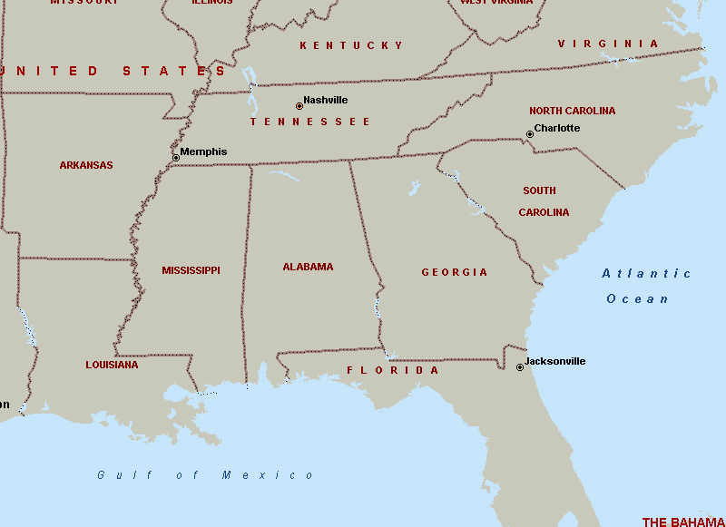

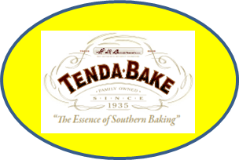
Sell Items where they are best sellers
#1 Biscuit Mix
Best Selling #1 Flour & Corn Meal Regional Brand
#1 IRI Loyalty Rating
#1 Flour & CM Regional Brand
#1 5lb SR Flour
#1 Selling Holiday Flour and Corn Meal
#1 5lb SR Flour
#1 Biscuit Mix
Source: IRI 2011-2012 52 weeks

Slide 43
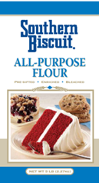
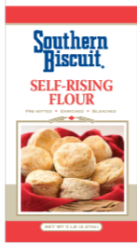
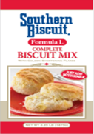
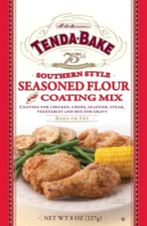
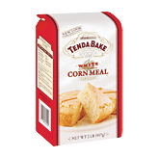
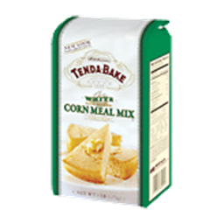
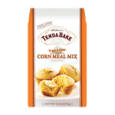
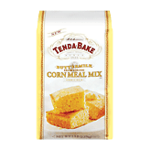
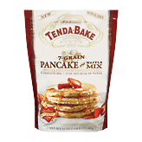
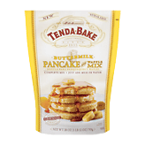
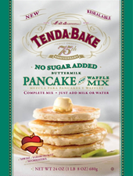
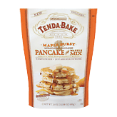
#1 HOLIDAY SEASON SELLING FLOUR
#1 SELLING FLOUR in SE USA
#1 SELLING BISCUIT MIX with only one s.k.u.
BEST SELLING SEASONED COATING /
LOWEST PRICE /
BRINGS NEW SHOPPERS to CATEGORY
#1 SELLING CORN MEAL in SE USA
#1 SELLING SPECIALTY
PANCAKE MIX with
INNOVATIVE ITEMS

Slide 44

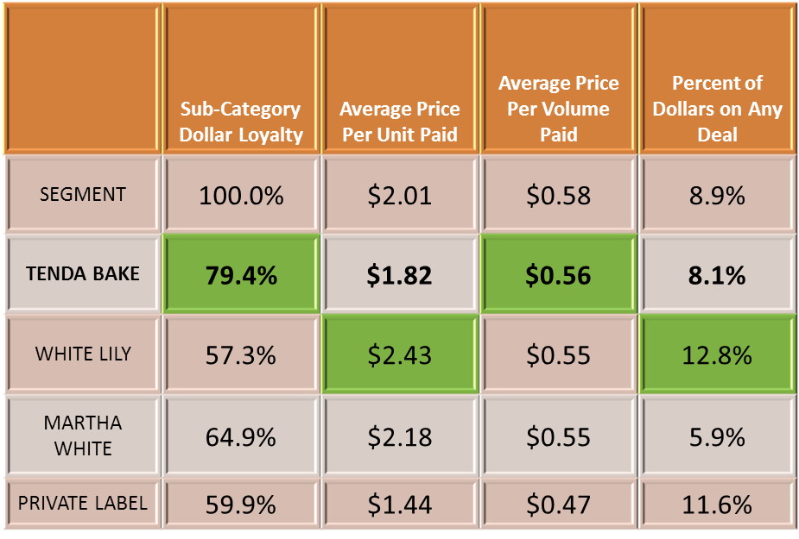
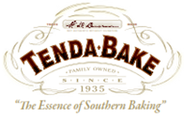
Tenda-Bake Brand commands
highest loyalty at 80% in 8 states market area
Brands in the category reflecting strong consumer shopper metrics in the South
66%
Indicates Brand Leadership
Shoppers will not substitute but go to a different store
Source: IRI Builders Suite Calendar Year 2009-12 – South Region

Slide 45
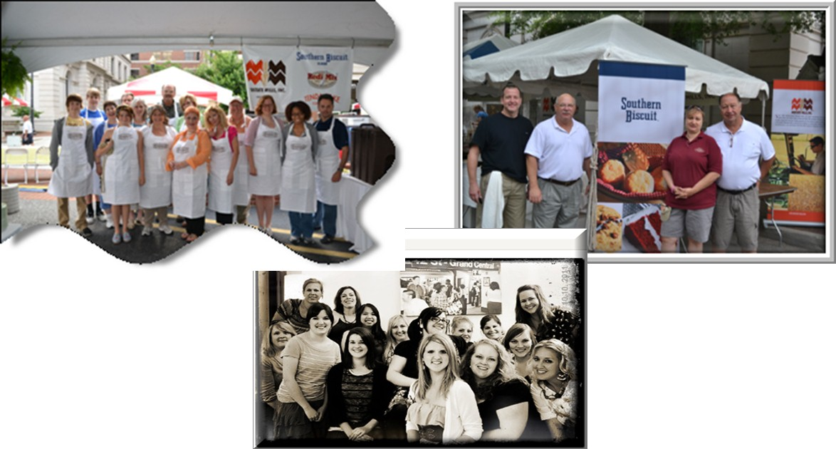
Renwood Mills
THANK YOU for your Business.
---------“This is all we do !”

